Slide 1
Python- Novice to Ninja
FEB 2017

Slide 2
Resources Online
Website
http://python.org/
- documentation, tutorials, beginners guide, core distribution, ...
Books include:
Learning Python by Mark Lutz
Python Essential Reference by David Beazley
Python Cookbook, ed. by Martelli, Ravenscroft and Ascher
(online at http://code.activestate.com/recipes/langs/python/)
http://wiki.python.org/moin/PythonBooks

Slide 3
3 Major Versions of Python
“Python” or “CPython” is written in C/C++
- Version 2.7 came out in mid-2010
- Version 3.1.2 came out in early 2010
“Jython” is written in Java for the JVM
“IronPython” is written in C# for the .Net environment

Slide 4
Development Environments
1. Pycharm from JetBrains
2. PyDev with Eclipse
3. Komodo
4. Emacs
5. Vim
6. Idle
7. NotePad++ (Windows)

Slide 5
Why to use Development Environments
Auto Complete
Dynamic typing – Semantic Error Checking
Nice error console!!
Integrated terminal
Run/Debug configuration
Advanced debugging options
Python colourising, Smart Indent
Project management, Version control

Slide 6
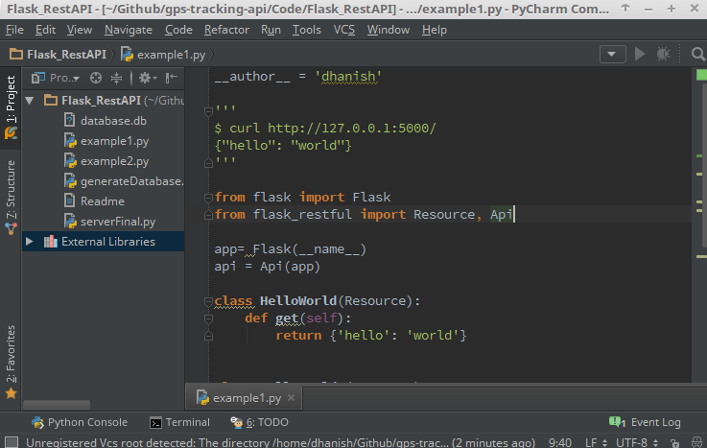
Pycharm IDE

Slide 7
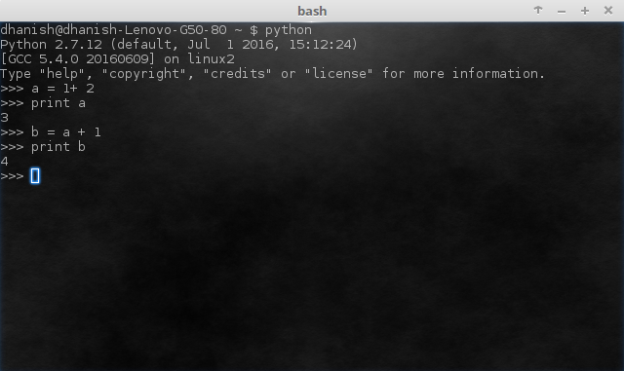
Python Interactive Shell

Slide 8
Python Programming
Data Types/Structure
Control flow
File I/O
Modules
Class

Slide 9
Python Programming
Data Types/Structure
Control flow
File I/O
Modules
Class

Slide 10
List
A compound data type: (examples)
[0]
[2.3, 4.5]
[5, "Hello", "there", 9.8]
[]
Use len() to get the length of a list
>>> names = [“Ben", “Chen", “Yaqin"]
>>> len(names)
3

Slide 11
List Indexing
>>> names[0]
‘Ben'
>>> names[1]
‘Chen'
>>> names[2]
‘Yaqin'
>>> names[3]
Traceback (most recent call last):
File "<stdin>", line 1, in <module>
IndexError: list index out of range
>>> names[-1]
‘Yaqin'
>>> names[-2]
‘Chen'
>>> names[-3]
‘Ben'
[0] is the first item.
[1] is the second item
...
Out of range values
raise an exception
Negative values
go backwards from
the last element.

Slide 12
Strings share many features with lists
>>> smiles = "C(=N)(N)N.C(=O)(O)O"
>>> smiles[0]
'C'
>>> smiles[1]
'('
>>> smiles[-1]
'O'
>>> smiles[1:5]
'(=N)'
>>> smiles[10:-4]
'C(=O)'

Slide 13
String Methods: find, split
smiles = "C(=N)(N)N.C(=O)(O)O"
>>> smiles.find("(O)")
15
>>> smiles.find(".")
9
>>> smiles.find(".", 10)
-1
>>> smiles.split(".")
['C(=N)(N)N', 'C(=O)(O)O']
>>>
Use “find” to find the
start of a substring.
Start looking at position 10.
Find returns -1 if it couldn’t
find a match.
Split the string into parts
with “.” as the delimiter

Slide 14
String operators: in, not in
if "Br" in “Brother”:
print "contains brother“
email_address = “clin”
if "@" not in email_address:
email_address += "@brandeis.edu“

Slide 15
String Method: “strip”, “rstrip”, “lstrip” are ways to remove whitespace or selected characters
>>> line = " # This is a comment line \n"
>>> line.strip()
'# This is a comment line'
>>> line.rstrip()
' # This is a comment line'
>>> line.rstrip("\n")
' # This is a comment line '
>>>

Slide 16
More String methods
email.startswith(“c") endswith(“u”)
True/False
>>> "%s@brandeis.edu" % "clin"
'clin@brandeis.edu'
>>> names = [“Ben", “Chen", “Yaqin"]
>>> ", ".join(names)
‘Ben, Chen, Yaqin‘
>>> “chen".upper()
‘CHEN'

Slide 17
Unexpected things about strings
>>> s = "andrew" #Strings are read only
>>> s[0] = "A"
Traceback (most recent call last):
File "<stdin>", line 1, in <module>
TypeError: 'str' object does not support item assignment
>>> s = "A" + s[1:]
>>> s
'Andrew‘

Slide 18
“\” is for special characters
\n -> newline
\t -> tab
\\ -> backslash
...
But Windows uses backslash for directories!
filename = "M:\nickel_project\reactive.smi" # DANGER!
filename = "M:\\nickel_project\\reactive.smi" # Better!
filename = "M:/nickel_project/reactive.smi" # Usually works

Slide 19
Lists are mutable - some useful methods
>>> ids = ["9pti", "2plv", "1crn"]
>>> ids.append("1alm")
>>> ids
['9pti', '2plv', '1crn', '1alm']
>>> del ids[0]
>>> ids
['2plv', '1crn', '1alm']
>>> ids.sort()
>>> ids
['1alm', '1crn', '2plv']
>>> ids.reverse()
>>> ids
['2plv', '1crn', '1alm']
>>> ids.insert(0, "9pti")
>>> ids
['9pti', '2plv', '1crn', '1alm']
append an element
remove an element
sort by default order
reverse the elements in a list
insert an element at some
specified position.
(Slower than .append())

Slide 20
Tuples: sort of an immutable list
>>> yellow = (255, 255, 0) # r, g, b
>>> one = (1,)
>>> yellow[0]
>>> yellow[1:]
(255, 0)
>>> yellow[0] = 0
Traceback (most recent call last):
File "<stdin>", line 1, in <module>
TypeError: 'tuple' object does not support item assignment
Very common in string interpolation:
>>> "%s lives in %s at latitude %.1f" % ("Andrew", "Sweden", 57.7056)
'Andrew lives in Sweden at latitude 57.7'

Slide 21
zipping lists together
>>> names
['ben', 'chen', 'yaqin']
>>> gender = [0, 0, 1]
>>> zip(names, gender)
[('ben', 0), ('chen', 0), ('yaqin', 1)]

Slide 22
Dictionaries
Dictionaries are lookup tables.
They map from a “key” to a “value”.
symbol_to_name = {
"H": "hydrogen",
"He": "helium",
"Li": "lithium",
"C": "carbon",
"O": "oxygen",
"N": "nitrogen"
}
Duplicate keys are not allowed
Duplicate values are just fine

Slide 23
Keys can be any immutable value numbers, strings, tuples, frozenset, not list, dictionary, set, ...
atomic_number_to_name = {
1: "hydrogen",
6: "carbon",
7: "nitrogen"
8: "oxygen",
}
nobel_prize_winners = {
(1979, "physics"): ["Glashow", "Salam", "Weinberg"],
(1962, "chemistry"): ["Hodgkin"],
(1984, "biology"): ["McClintock"],
}

Slide 24
Dictionary
>>> symbol_to_name["C"]
'carbon'
>>> "O" in symbol_to_name, "U" in symbol_to_name
(True, False)
>>> "oxygen" in symbol_to_name
False
>>> symbol_to_name["P"]
Traceback (most recent call last):
File "<stdin>", line 1, in <module>
KeyError: 'P'
>>> symbol_to_name.get("P", "unknown")
'unknown'
>>> symbol_to_name.get("C", "unknown")
'carbon'

Slide 25
Some useful dictionary methods
>>> symbol_to_name.keys()
['C', 'H', 'O', 'N', 'Li', 'He']
>>> symbol_to_name.values()
['carbon', 'hydrogen', 'oxygen', 'nitrogen', 'lithium', 'helium']
>>> symbol_to_name.update( {"P": "phosphorous", "S": "sulfur"} )
>>> symbol_to_name.items()
[('C', 'carbon'), ('H', 'hydrogen'), ('O', 'oxygen'), ('N', 'nitrogen'), ('P', 'phosphorous'), ('S', 'sulfur'), ('Li', 'lithium'), ('He', 'helium')]
>>> del symbol_to_name['C']
>>> symbol_to_name
{'H': 'hydrogen', 'O': 'oxygen', 'N': 'nitrogen', 'Li': 'lithium', 'He': 'helium'}

Slide 26
Python Programming
Data Types/Structure
Control flow
File I/O
Modules
Class

Slide 27
Control Flow
Things that are False
The boolean value False
The numbers 0 (integer), 0.0 (float) and 0j (complex).
The empty string "".
The empty list [], empty dictionary {} and empty set set().
Things that are True
The boolean value True
All non-zero numbers.
Any string containing at least one character.
A non-empty data structure.

Slide 28
If
>>> smiles = "BrC1=CC=C(C=C1)NN.Cl"
>>> bool(smiles)
True
>>> not bool(smiles)
False
>>> if not smiles:
... print "The SMILES string is empty"
...
The “else” case is always optional

Slide 29
Use “elif” to chain subsequent tests
>>> mode = "absolute"
>>> if mode == "canonical":
... smiles = "canonical"
... elif mode == "absolute":
... smiles = "absolute"
... else:
... raise TypeError("unknown mode")
...
>>> smiles
' absolute '
>>>
“raise” is the Python way to raise exceptions

Slide 30
Boolean logic
Python expressions can have “and”s and “or”s:
if (ben <= 5 and chen >= 10 or chen == 500 and ben != 5):
print “Ben and Chen“

Slide 31
Range Test
Time = 10
if (9 <= Time <= 5):
print “College Hour"

Slide 32
For
>>> names = [“Ben", “Chen", “Yaqin"]
>>> for name in names:
... print smiles
...
Ben
Chen
Yaqin

Slide 33
Break, continue
>>> for value in [3, 1, 4, 1, 5, 9, 2]:
... print "Checking", value
... if value > 8:
... print "Exiting for loop"
... break
... elif value < 3:
... print "Ignoring"
... continue
... print "The square is", value**2
...

Slide 34
Range()
“range” creates a list of numbers in a specified range
range([start,] stop[, step]) -> list of integers
When step is given, it specifies the increment (or decrement).
>>> range(5)
[0, 1, 2, 3, 4]
>>> range(5, 10)
[5, 6, 7, 8, 9]
>>> range(0, 10, 2)
[0, 2, 4, 6, 8]
How to get every second element in a list?
for i in range(0, len(data), 2):
print data[i]

Slide 35
Python Programming
Data Types/Structure
Control flow
File I/O
Modules
Class

Slide 36
Reading files
>>> f = open(“names.txt")
>>> f.readline()
'Yaqin\n'

Slide 37
File Output
input_file = open(“in.txt")
output_file = open(“out.txt", "w")
for line in input_file:
output_file.write(line)
“w” = “write mode”
“a” = “append mode”
“wb” = “write in binary”
“r” = “read mode” (default)
“rb” = “read in binary”
“U” = “read files with Unix
or Windows line endings”

Slide 38
Python Programming
Data Types/Structure
Control flow
File I/O
Modules
Class

Slide 39
Modules
When a Python program starts it only has access to a basic functions and classes.
(“int”, “dict”, “len”, “sum”, “range”, ...)
“Modules” contain additional functionality.
Use “import” to tell Python to load a module.
>>> import math

Slide 40
import the math module
>>> import math
>>> math.pi
3.1415926535897931
>>> math.cos(math.pi)
-1.0
>>> dir(math)
['__doc__', '__file__', '__name__', '__package__', 'acos', 'acosh', 'asin', 'asinh', 'atan', 'atan2', 'atanh', 'ceil', 'copysign', 'cos', 'cosh', 'degrees', 'e', 'exp', 'fabs', 'factorial', 'floor', 'fmod', 'frexp', 'fsum', 'hypot', 'isinf', 'isnan', 'ldexp', 'log', 'log10', 'log1p', 'modf', 'pi', 'pow', 'radians', 'sin', 'sinh', 'sqrt', 'tan', 'tanh', 'trunc']
>>> help(math)
>>> help(math.cos)

Slide 41
“import” and “from ... import ...”
>>> import math
math.cos
>>> from math import cos, pi
cos
>>> from math import *
cos, pi, sin ….

Slide 42
Python Programming
Data Types/Structure
Control flow
File I/O
Modules
Class

Slide 43
Classes
class ClassName(object):
<statement-1>
. . .
<statement-N>
class MyClass(object):
"""A simple example class"""
i = 12345
def f(self):
return self.i

Slide 44
Thank You

